Slide 1
iBoxx Total Return Swaps
What is it?
A total return swap, TRS, allows an investor to gain exposure to a specified index (i.e. bond, equity, fx, etc.) through a swap contract.
A TRS consists of two legs, the index leg and the funding leg. At the maturity of the contract, the buyer of a TRS will receive the cumulative return of the index (index leg) in exchange for a running payment of Libor/Euribor plus a fixed spread (funding leg). The trade is unfunded in the sense that there is no initial exchange of principal only exchange of returns.
The index leg consists of one sole payment at the maturity of the contract. iBoxx indices are quoted with an index level which measures the total return of the underlying index.
The fixed spread in the funding leg incorporates the cost of hedging the TRS as well as the demand to receive or pay the index return.

Slide 2
iBoxx EUR Corporates Index Swap Example as of June 6th 2012
Trade Terms:
- Index Buyer: Party A
- Index Seller: Party B
- Settlement Currency: Euro
- Floating Amount: 3m Euribor -63 / -33 bps
- Spread: 20 bps
- Initial Fixing: 178.81 / 178.99
- TRS Maturity: 12m (June 20th 2013)
Party A:
- Pays running ((3m Euribor 33bps (Q, ACT/360)) + Spread (20 bps)) * Notional
- Receives sole payment on TRS Maturity date
- Final payment equal to ((Final Index level – 178.99) / 178.99) * Notional
Party B:
- Receives running ((3m Euribor 63bps (Q, ACT/360)) + Spread(20 bps)) * Notional
- Pays sole payment on TRS Maturity date
- Final payment equal to ((Final Index level – 178.99) / 178.99) * Notional

Slide 3
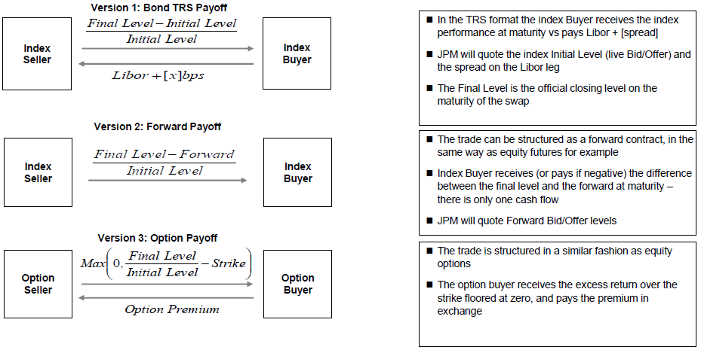
TRS Mechanics Continued…

Slide 4
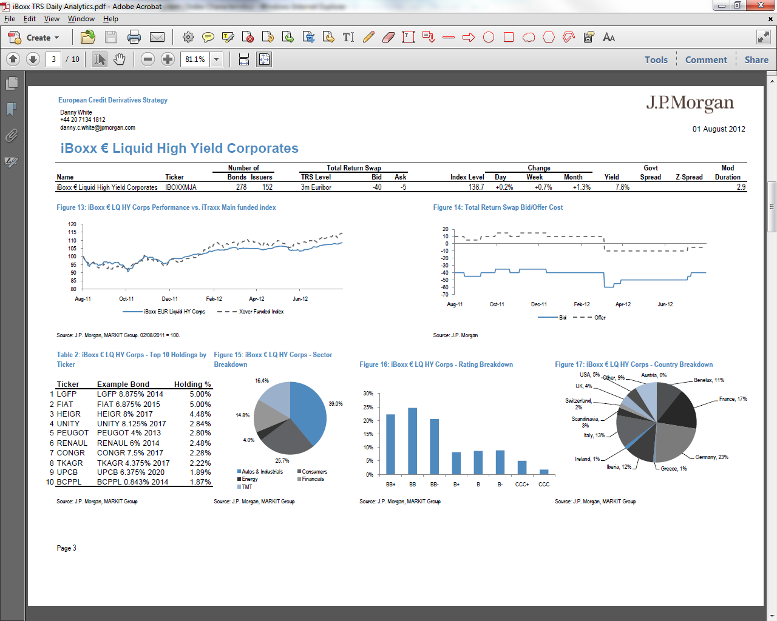
iBoxx EUR Liquid HY Index Breakdown

Slide 5
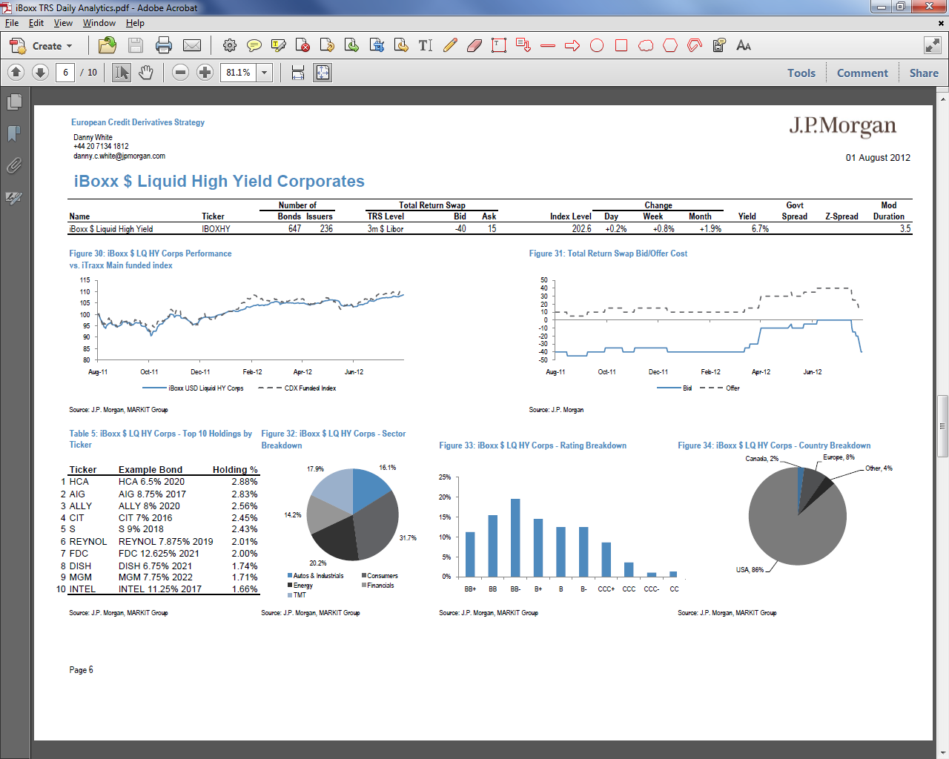
iBoxx USD Liquid HY Index Breakdown

Slide 6
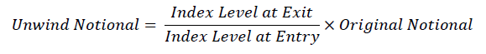
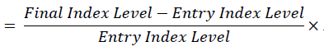
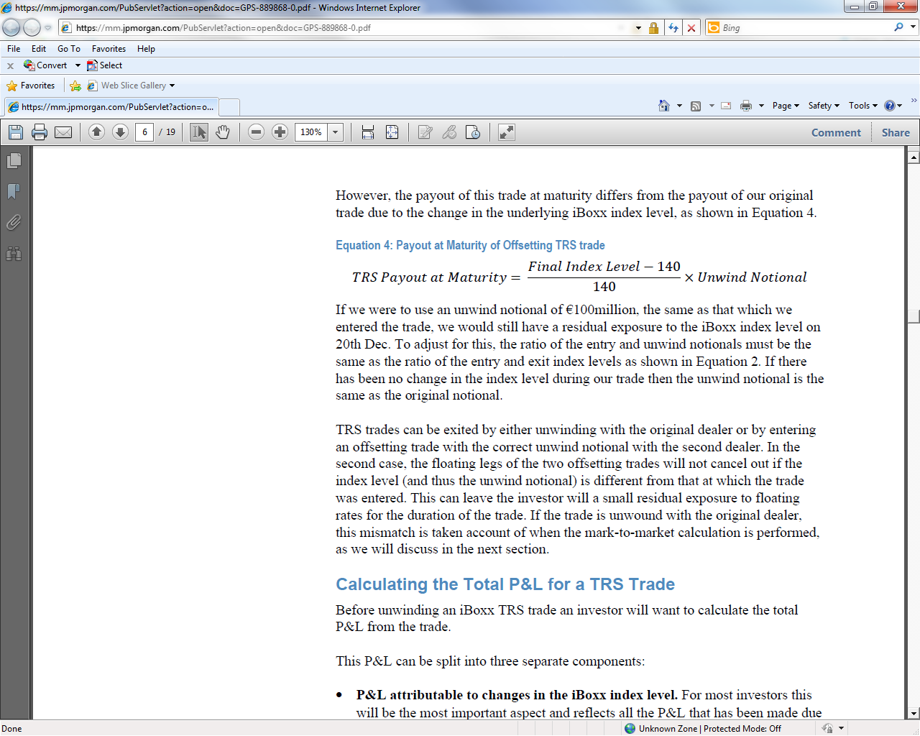

Unwinding an iBoxx TRS trade
As of June 2011, the introduction of standardized documentation for TRS now means that trades with different dealers are fully fungible; trades can be entered with one dealer and unwound with another.
When unwinding a TRS trade, calculating the payout for the buyer is straightforward as shown below

Slide 7
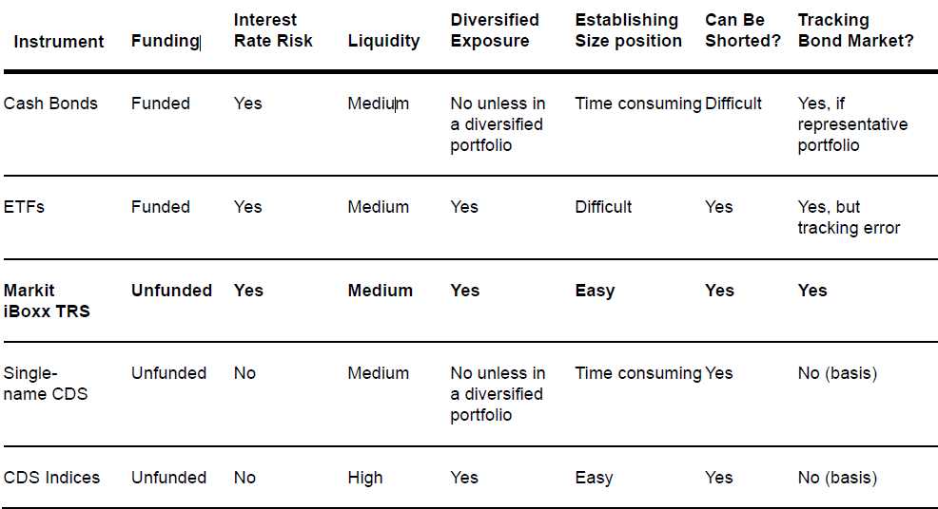
Markit iBoxx TRS vs. Other Market Instruments

